Slide 1
Data science capstone
Allison Fernandez
March 2020

Slide 2
Business Problem
The objective of this capstone project is to analyze and select the best locations within Indianapolis to recommend to a family who enjoys fitness, being outdoors, exploring cafes, and going out to eat. Through web scraping, clustering and visualizing data, a fictitious family will be able to decide which neighborhood among the top five safest zip codes in Indianapolis to move to. This neighborhood will contain the most venues that appeal to the family’s interests.

Slide 3
Data Required
To solve the problem, we will need the following data:
The safest neighborhoods in Indianapolis.
The Zip Codes of the safest neighborhoods in Indianapolis.
The latitudes and longitudes of these zip codes.
Venues that are within these zip codes.

Slide 4
Methodology
Install BeautifulSoup
Web Scrape the safest neighborhoods in Indianapolis from neighborhoodscout.com
Convert to pandas dataframe
Upload and append latitude and longitude information for each zip code from public.opendatasoft.com
Use Geopy and Geopandas for visualization
Find unique categories and filter based on family’s interests
Use Folium to add markers for venues in each zip code

Slide 5
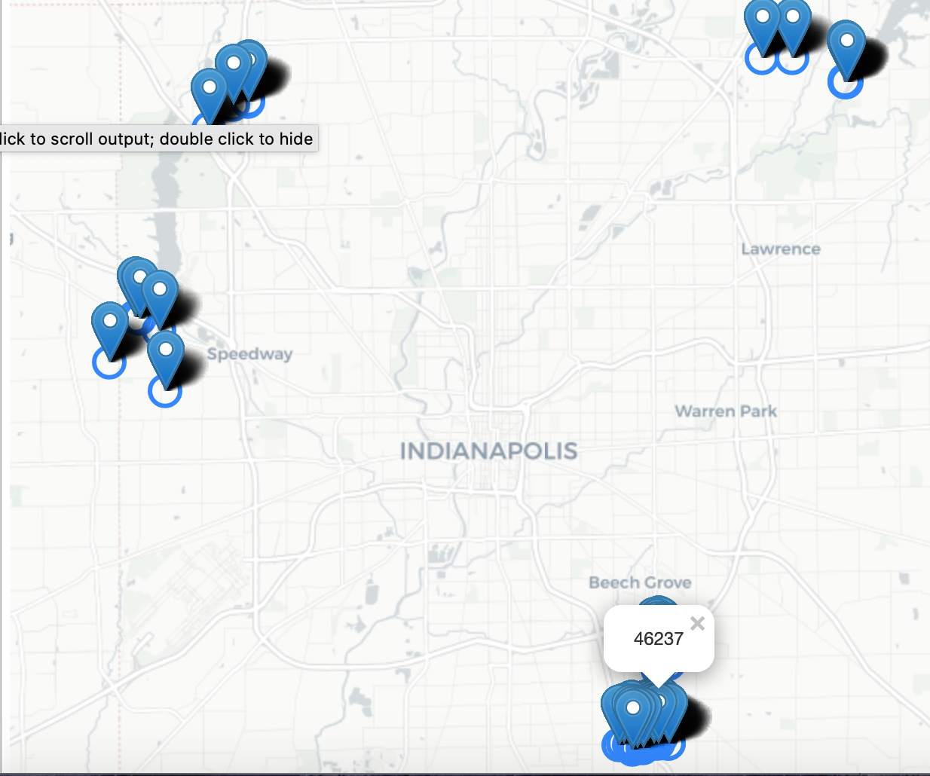
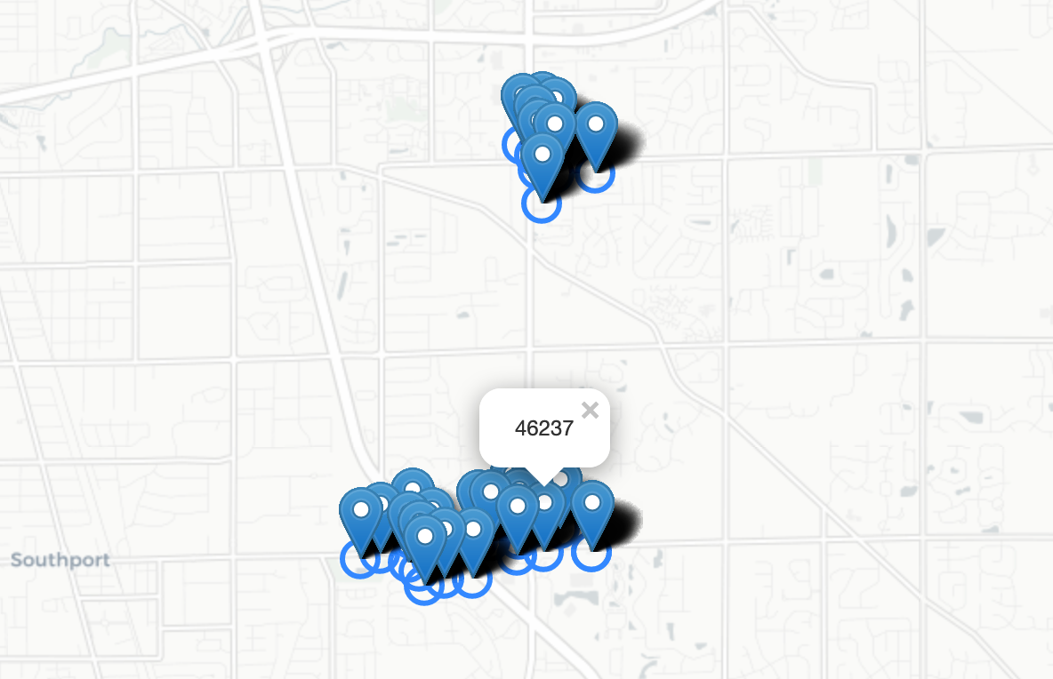
Results
Five Clusters with marked venues placed over a map of Indianapolis
Final inspection shows that the largest cluster of relevant venues come from 46237, or the Arlington Ave/Shelbyville Road neighborhood.

Slide 6
Discussion
From our observations in the results section, we can see that the Arlington neighborhood has the highest number of relevant venues for our fictional family. While there are other safe zip codes that contain similar venues, none of them are as concentrated as zip code 46352. Another observation shows that southeast Indianapolis may have a higher population and more things to do than these other areas, implying that it is not as big of a farming area as the other areas observed. Although it ranks fourth on the list of safest neighborhoods, this is out of more than 113 neighborhoods within Indianapolis. It’s still a great choice.

Slide 7
Recommendations
In this project, I examined data based off of five neighborhoods. Further research could color-code each zip code in terms of safety and examine the distance each one is from the airport, downtown Indianapolis, and nearby states (you know, in case of a zombie apocalypse and the need to flee from the state to a safe area.)

Slide 8
Conclusion
The family is best suited to move to Arlington Avenue in southeast Indianapolis. This methodology would be useful for people starting a new chapter of life by moving to a brand new area where they do not know anyone.

